Slide 1
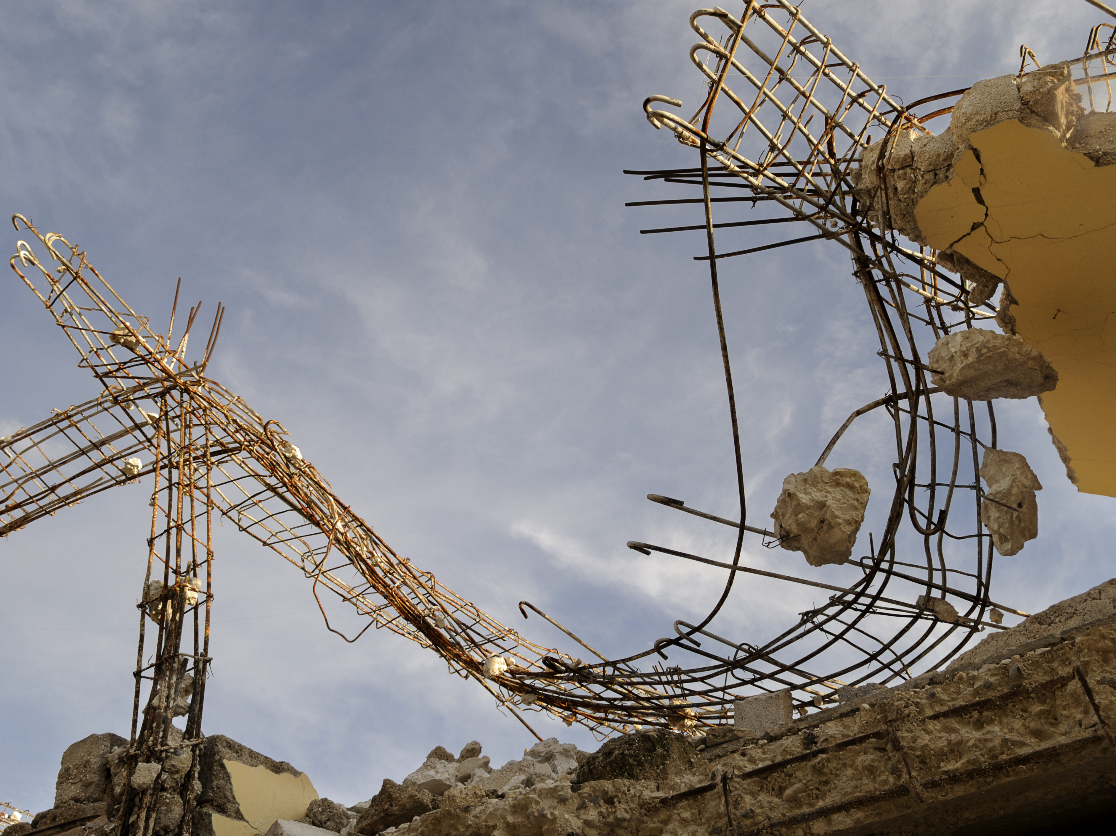


GEM FOUNDATION
^{FOR A WORLD}
THAT IS RESILIENT TO EARTHQUAKES.

Slide 2
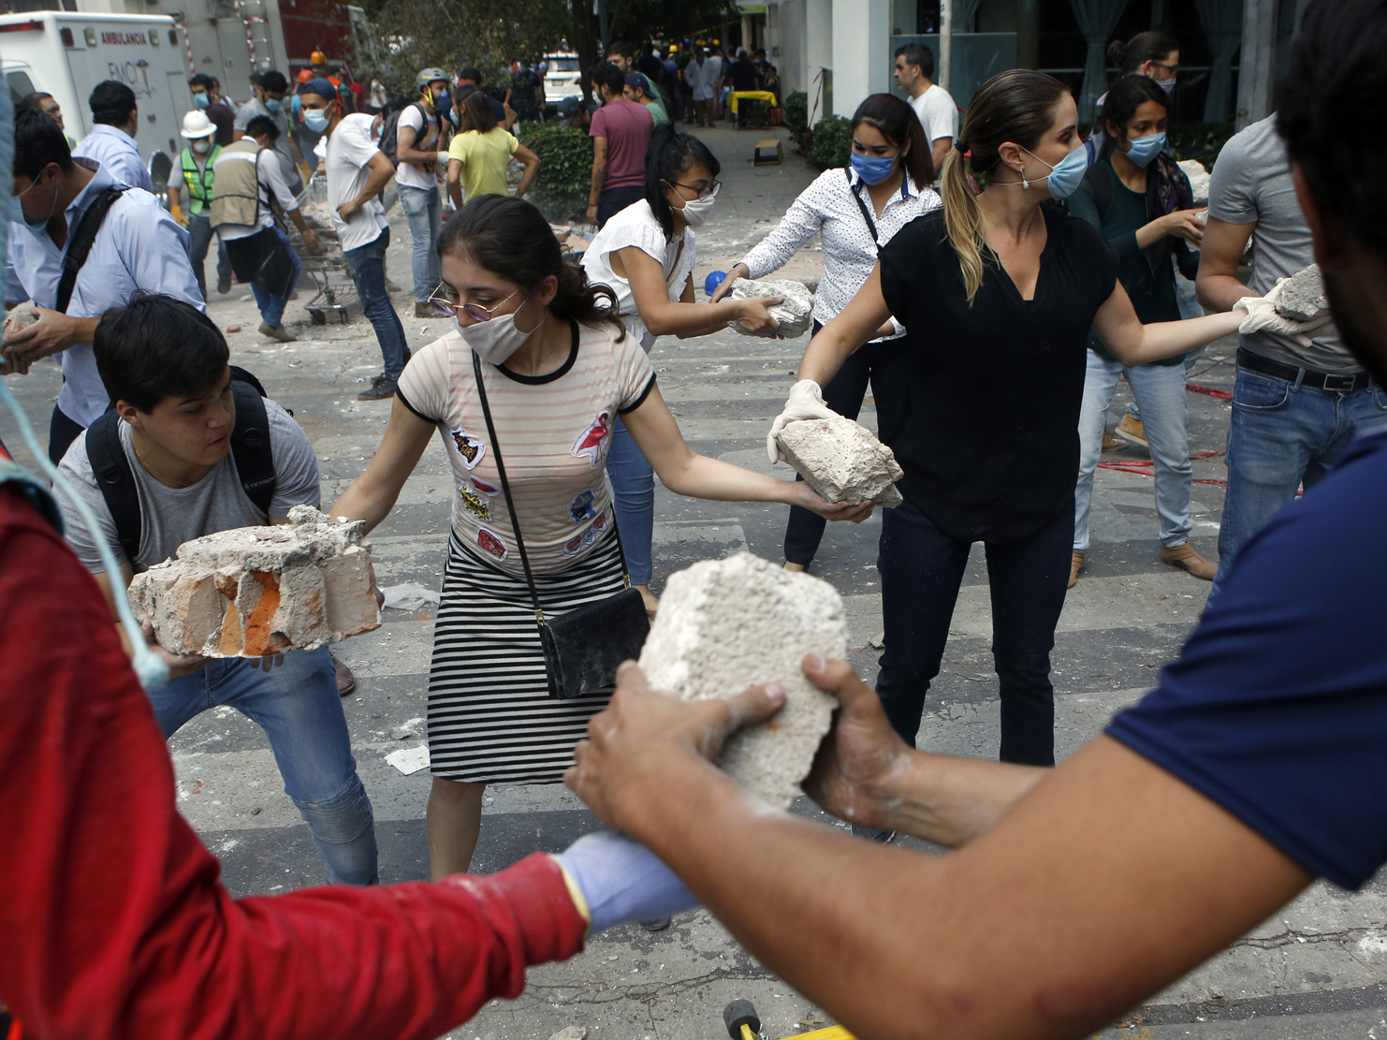
VISION AND MISSION
^{A world} that is resilient to earthquakes.

Slide 3
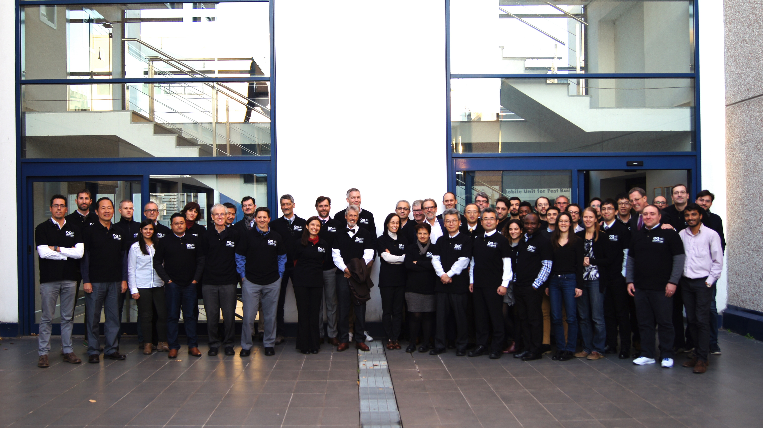
GEM TEAM
GEM Secretariat staff with the Governing Board members, December 2017
GEM is comprised of collaborators from public, private, academic and non-government organizations worldwide. These partners work together to advance the state-of-the-art for disaster risk reduction by developing data, tools and information for improving our understanding of earthquake hazard and risk globally.

Slide 4
2009-2018 SPONSORS

Slide 5
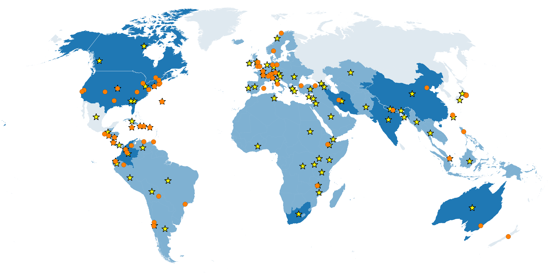
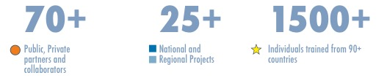
GEM AT A GLANCE

Slide 6
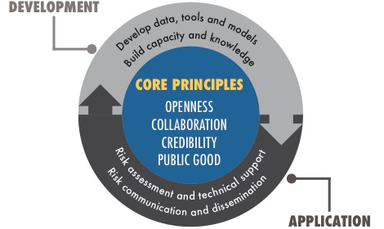
FRAMEWORK

Slide 7
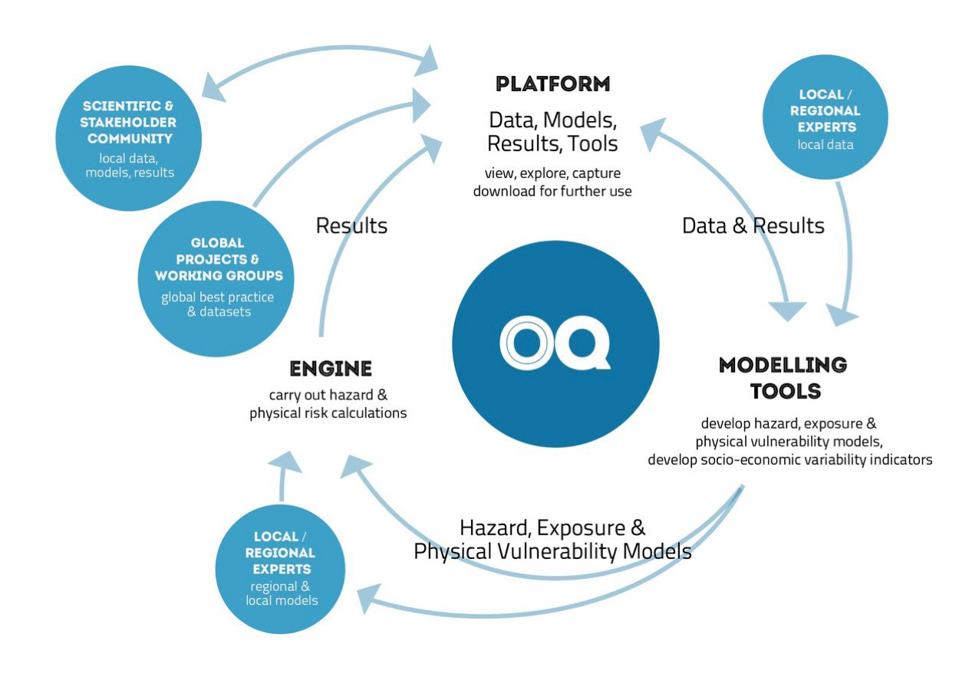
OPENQUAKE - engine

Slide 8
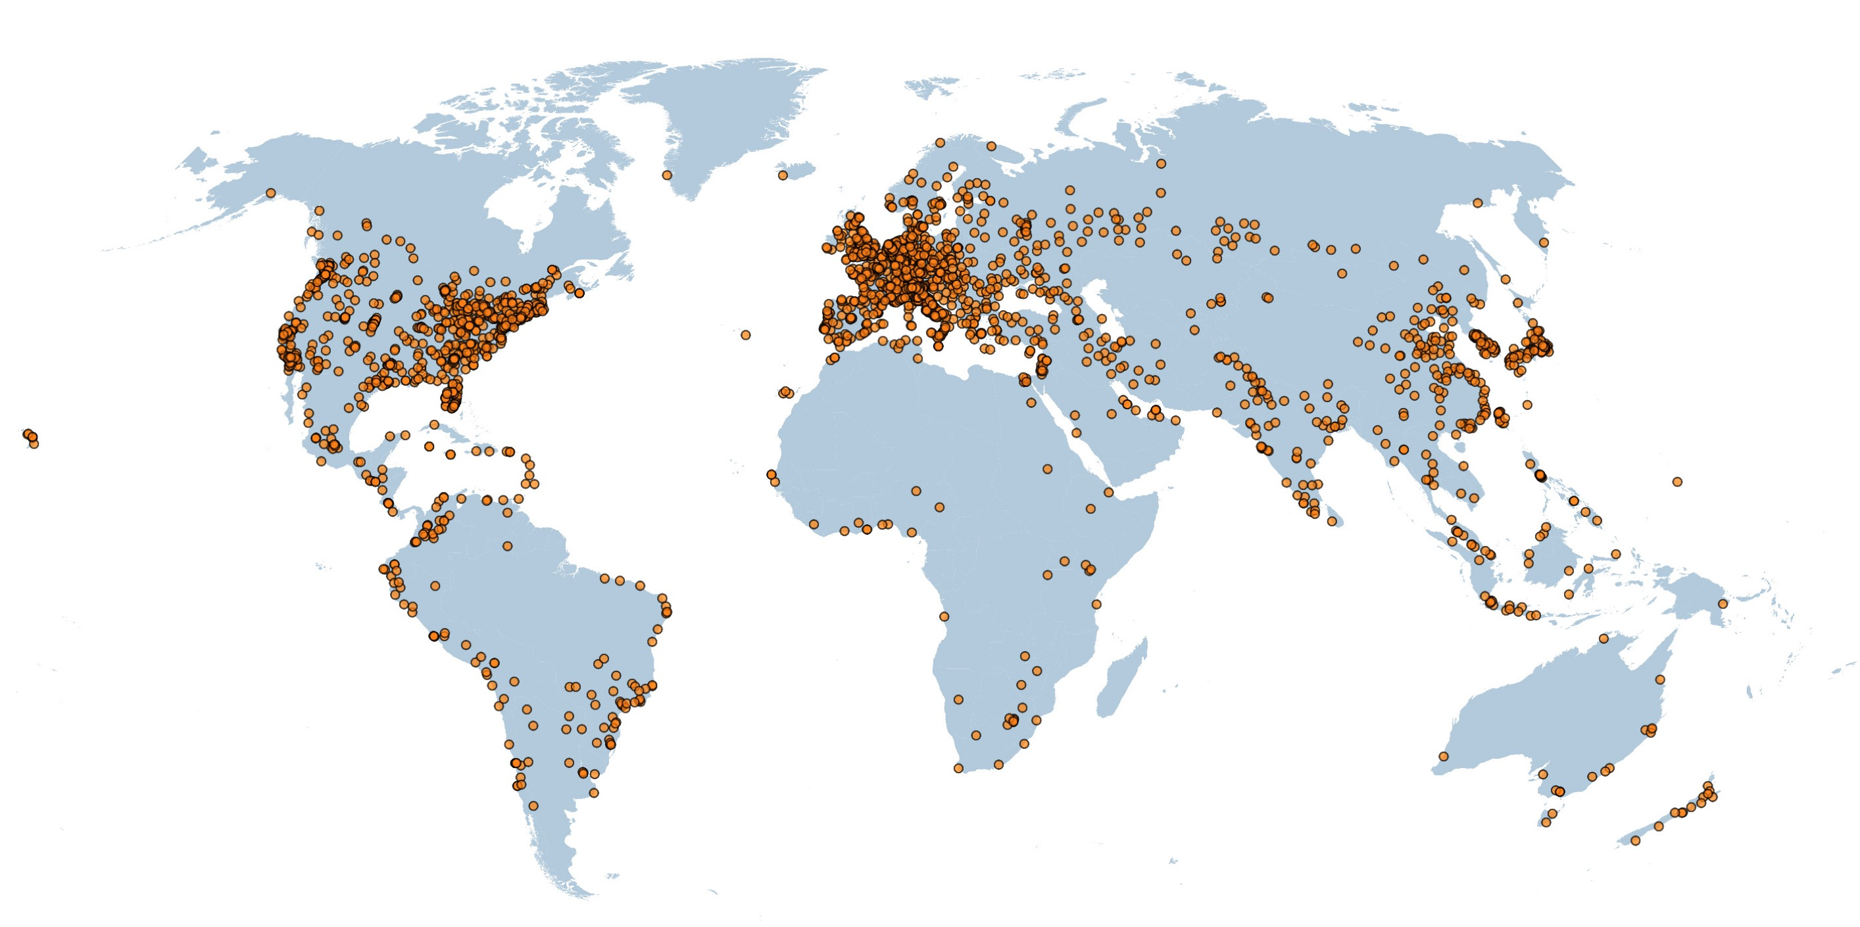
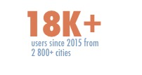
OPENQUAKE PLATFORM

Slide 9
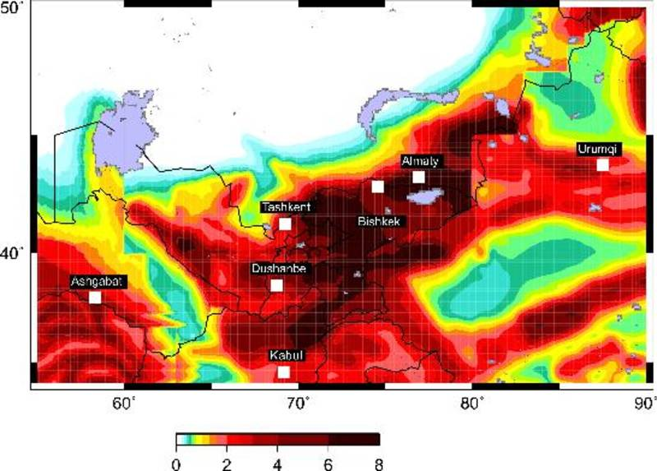
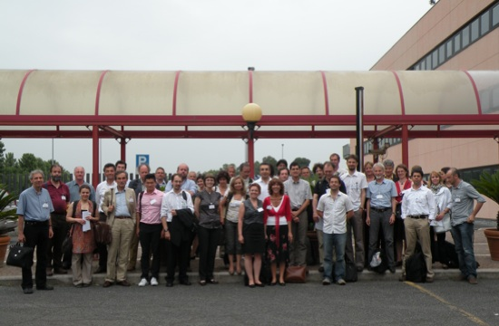
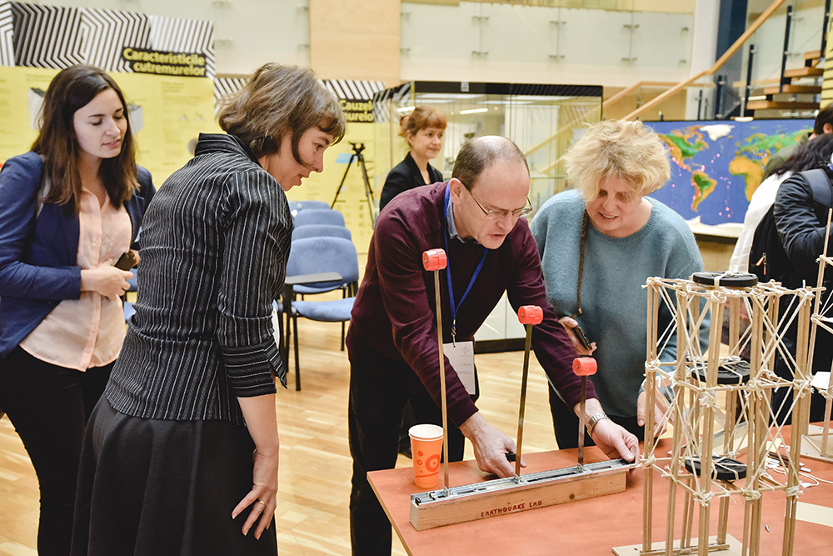
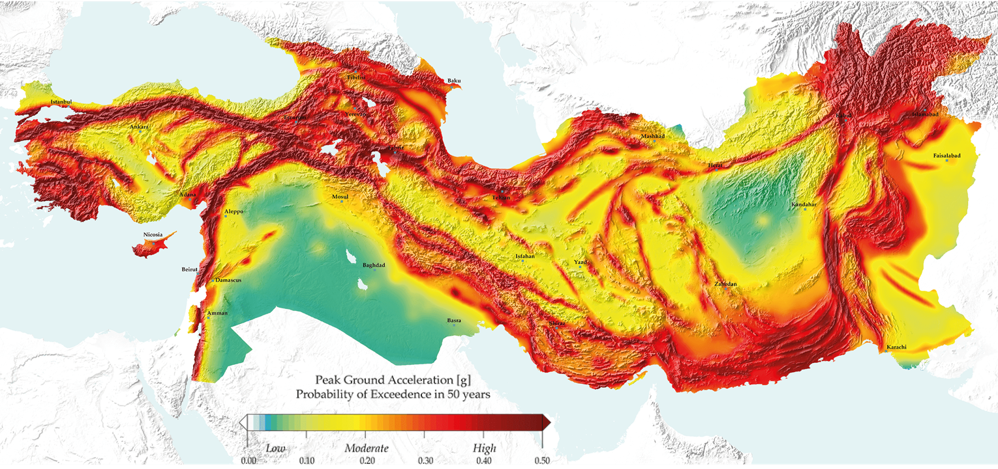
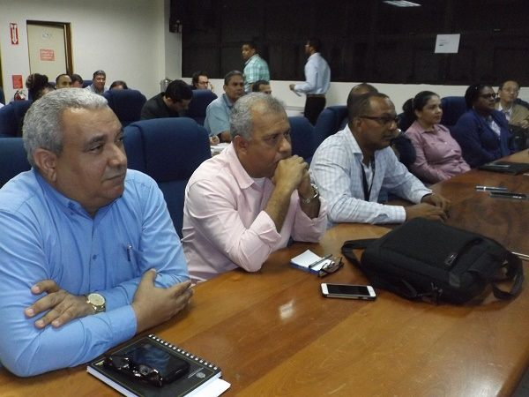
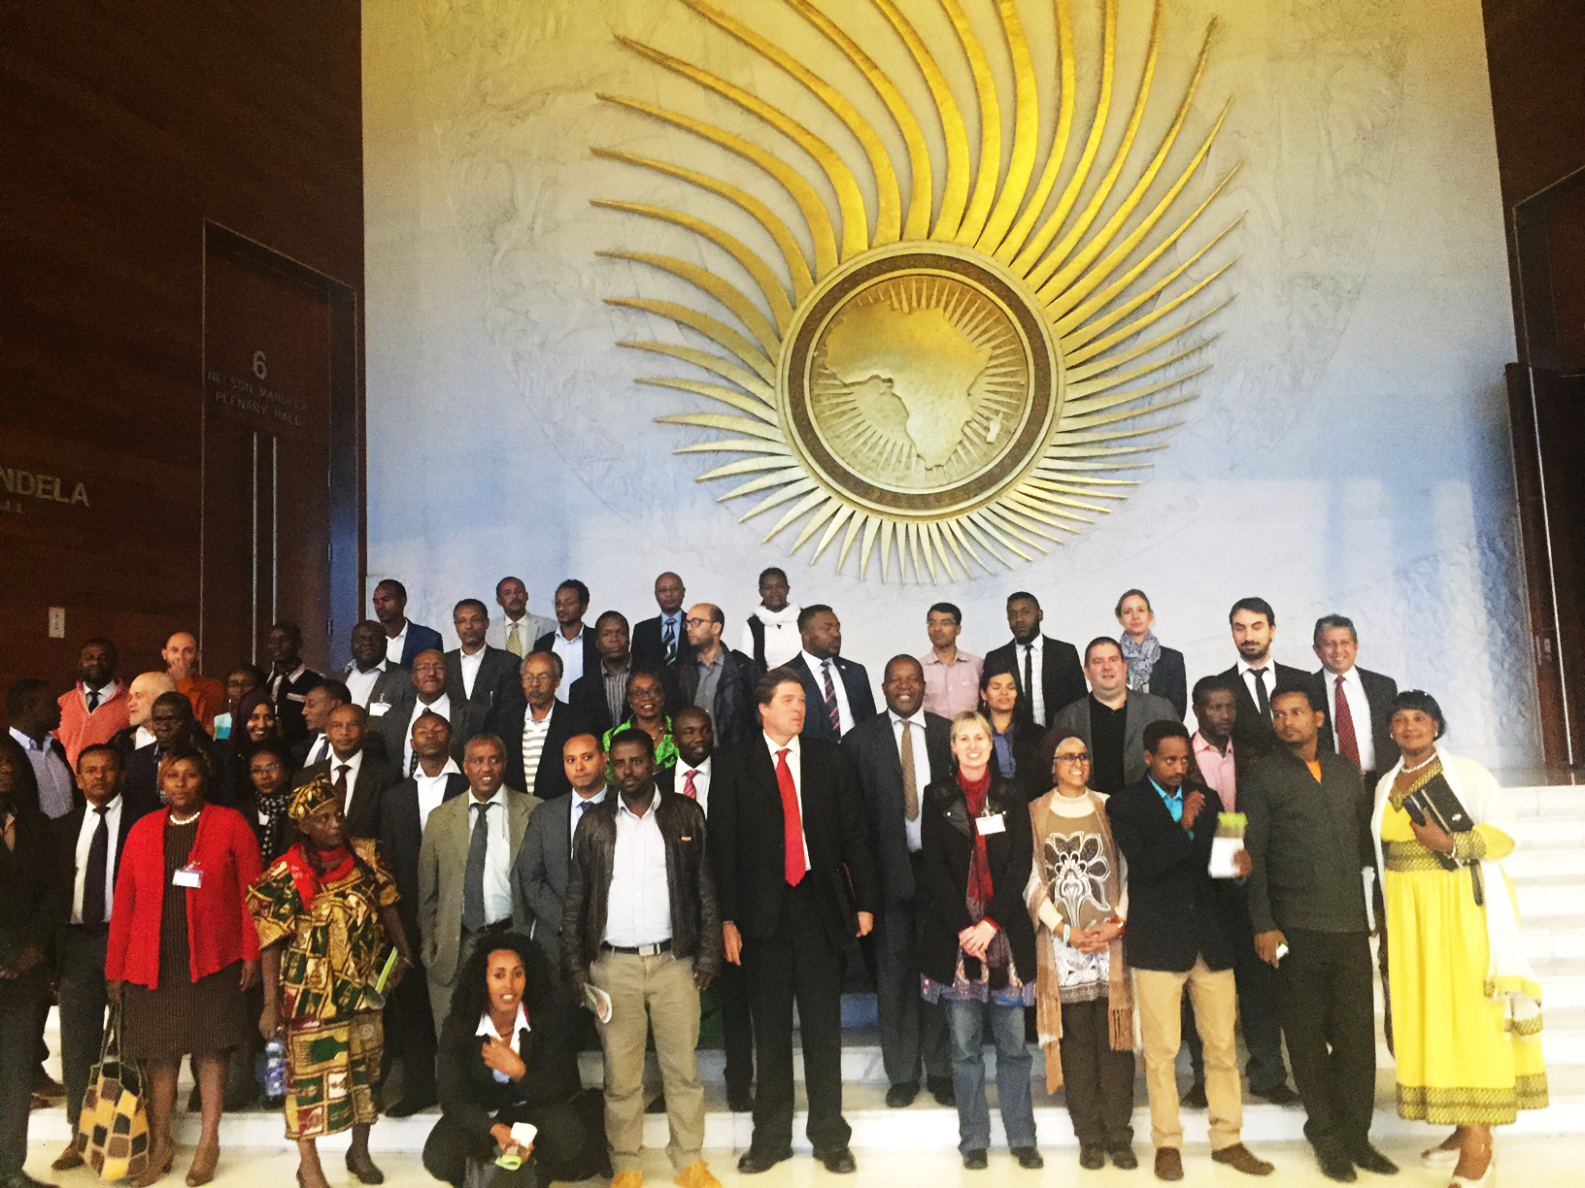
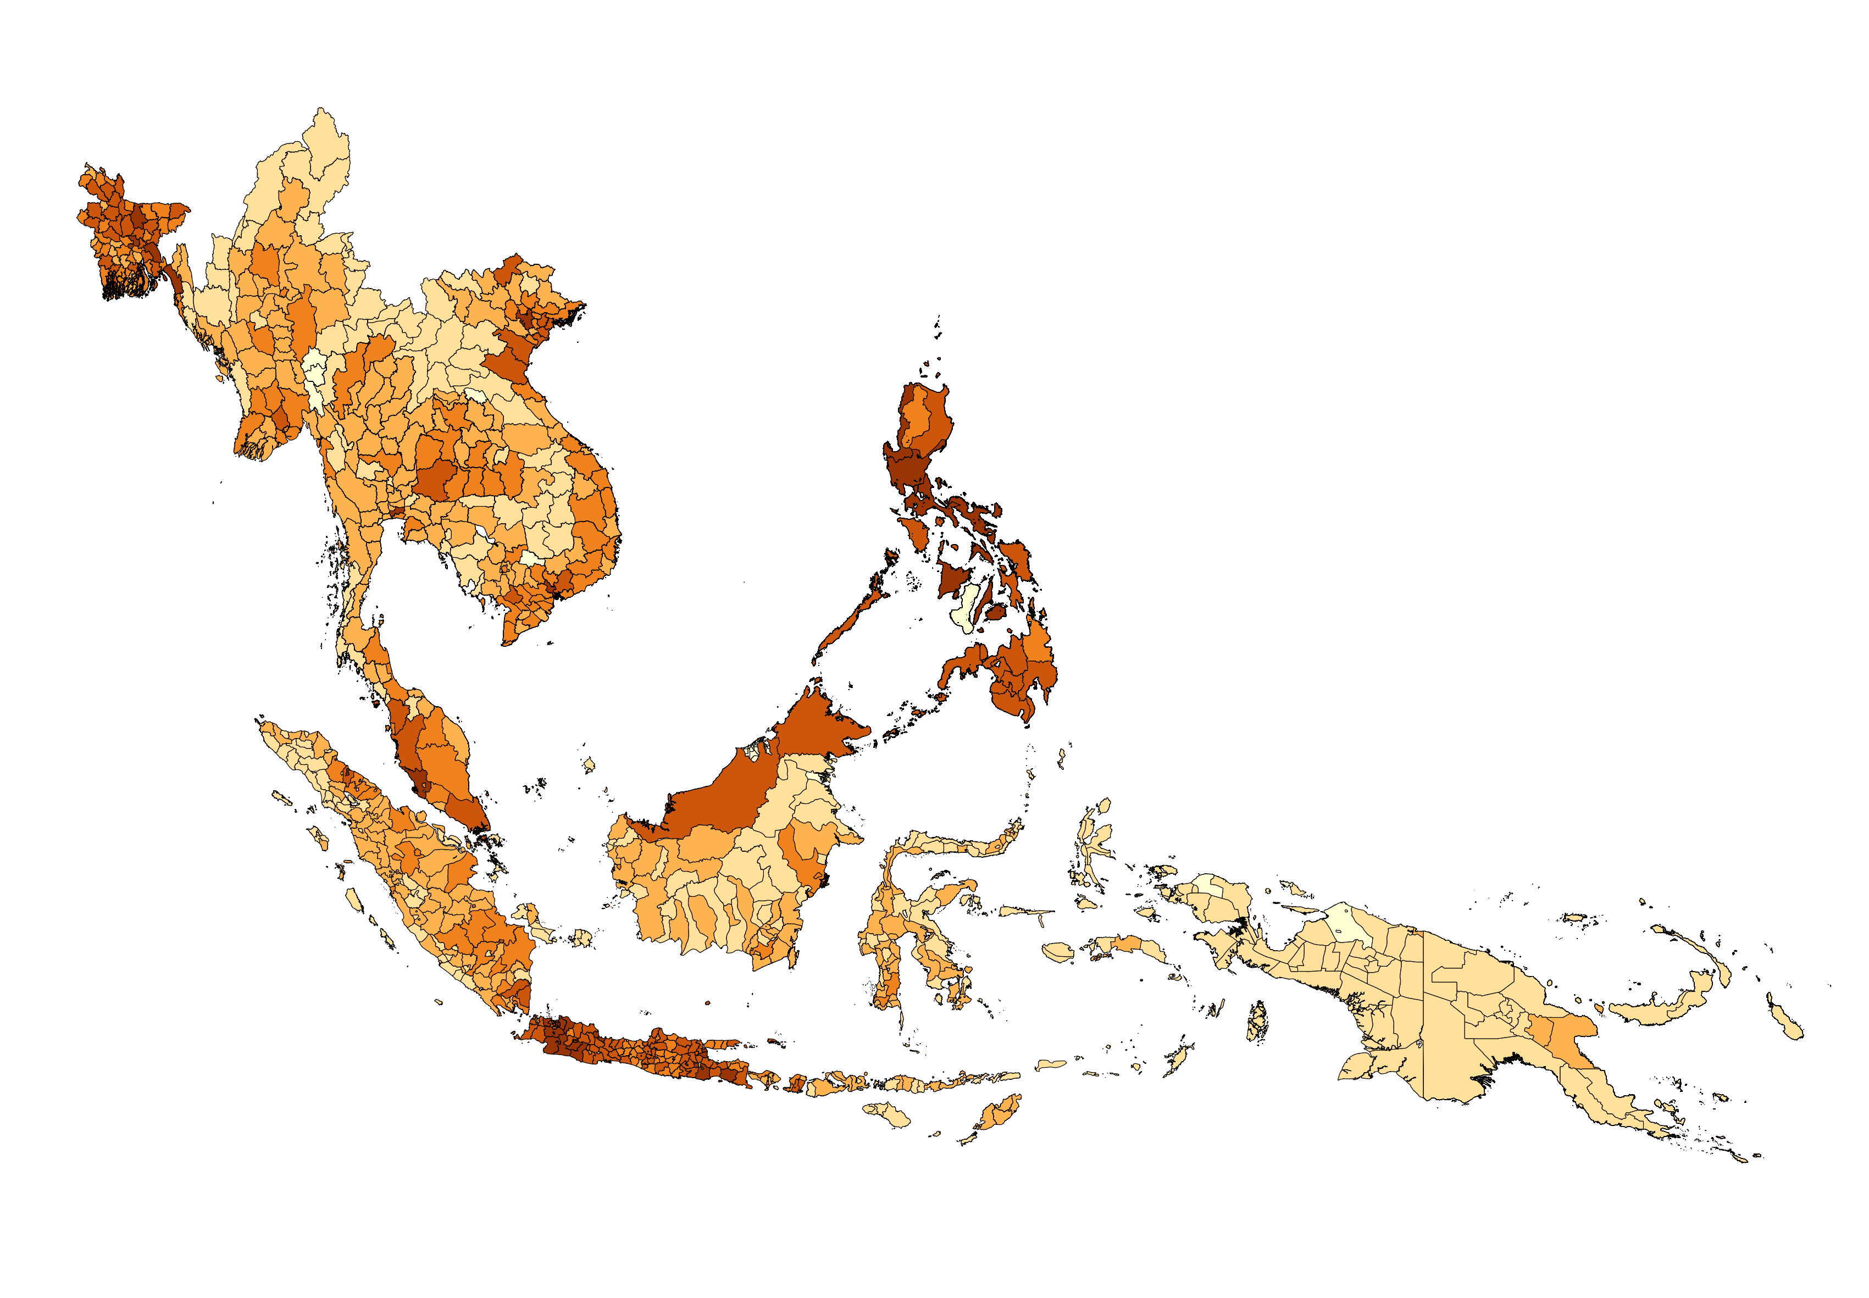
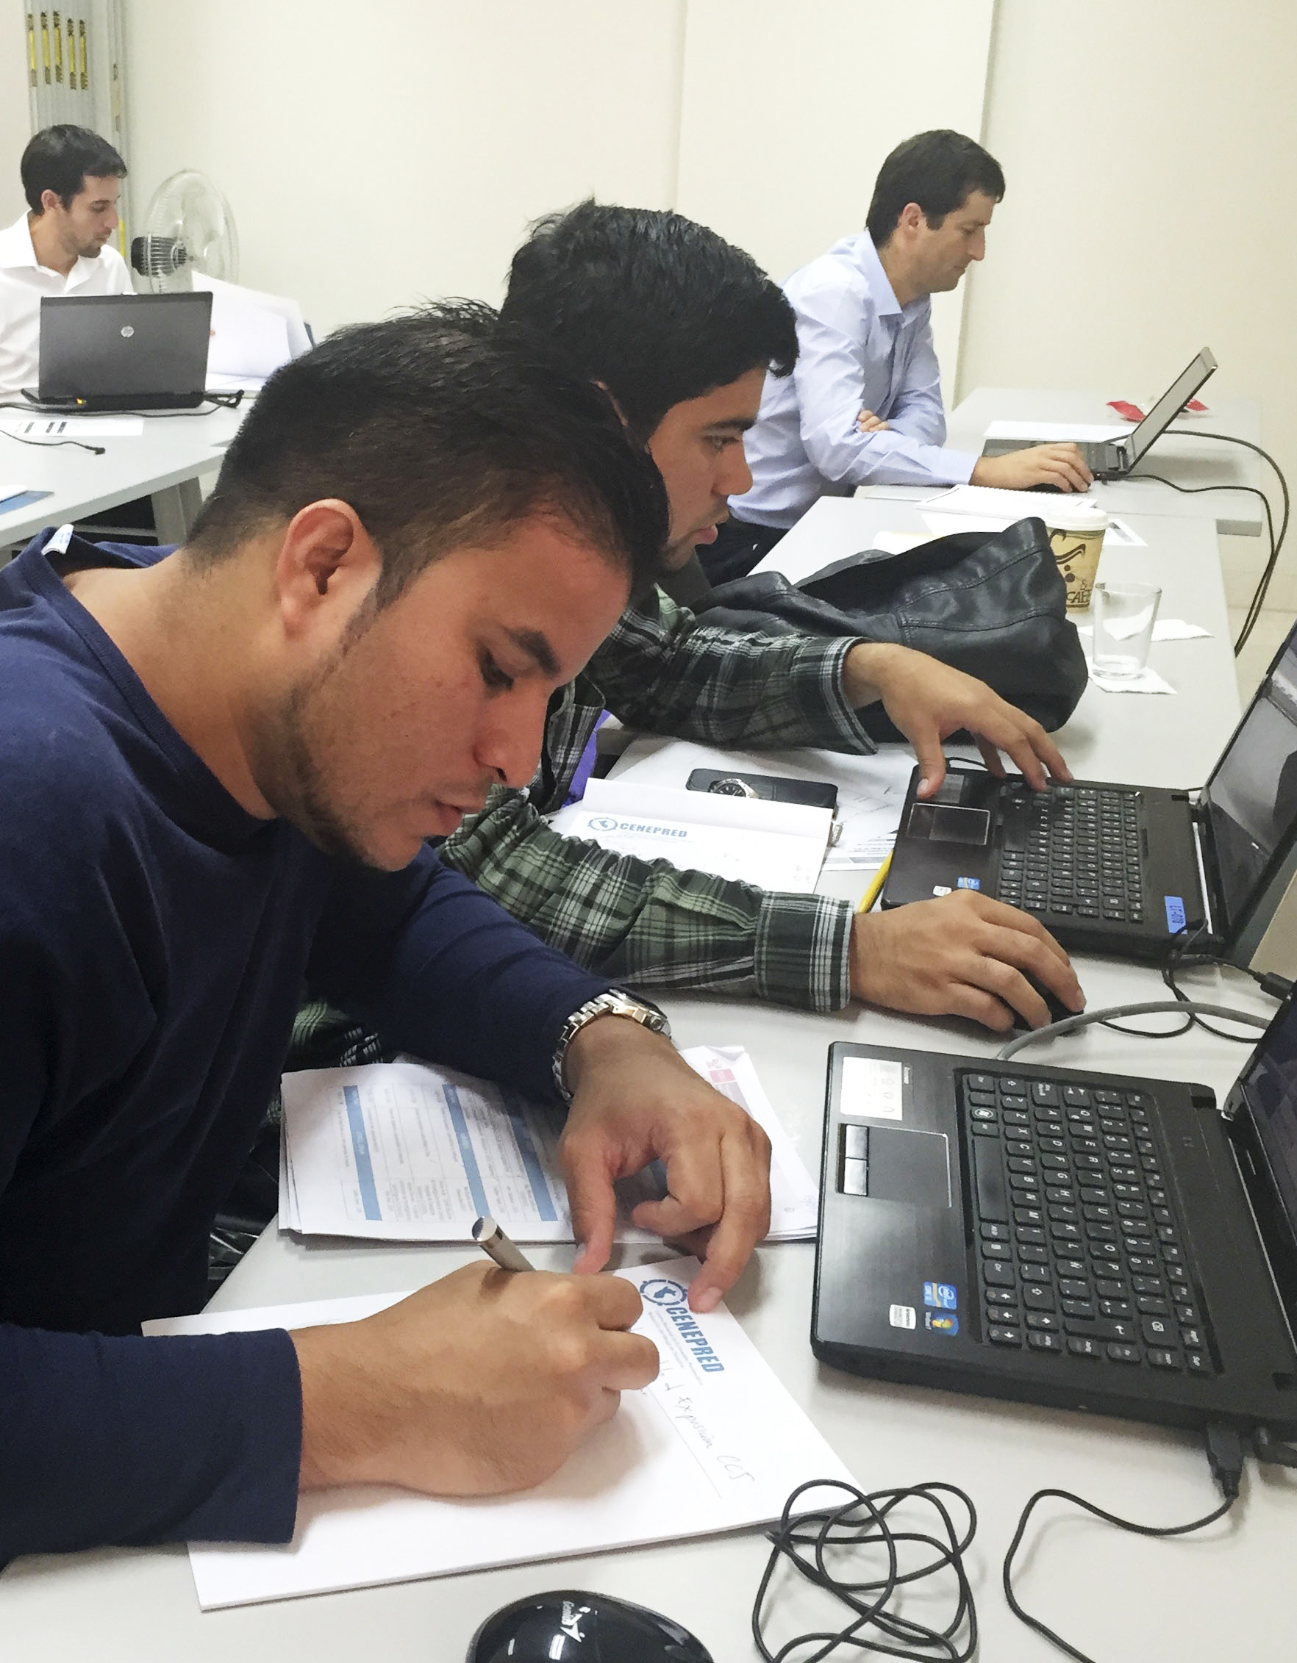
LOCAL TO REGIONAL PROJECTS
British Columbia, Canada
EMCA
SHARE
SERA
California, USA
Armenia
Kyrgyzstan
EMME
Iran
CCARA
SEARA
Philippines
Colombia
SSAHARA
SARA
South Africa
Perth, Australia
National/Local
New Zealand
Regional

Slide 10
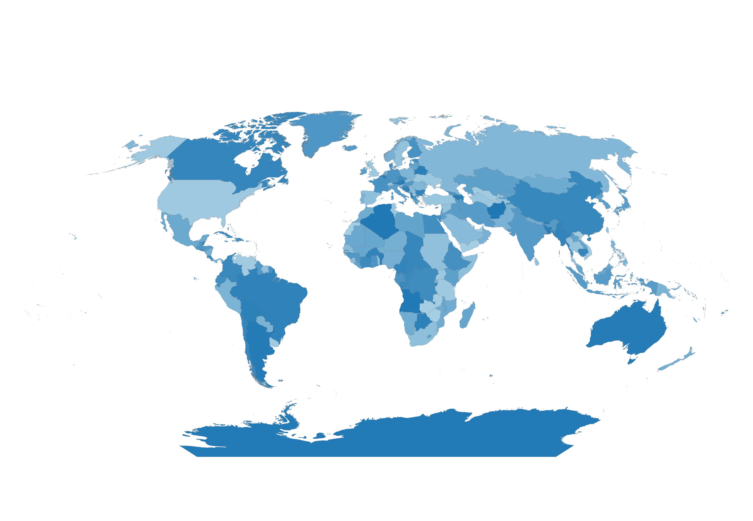
GLOBAL PROJECTS
Title | Period | Partners | Funders
GFDRR-DFID – Challenge Funds | 2017 - 2018 | HOT, ImageCat, BGS, UCL, CIMA, Norwegian Geotechnical Institute | GFDRR-DFID
Global Active Fault Database | 2017 - 2018 | Public and private institutions; local, national and global collaborators | United States Agency for International Development (USAID)
Collaborative Risk Assessment for Volcanoes and Earthquakes (CRAVE) | 2017 - 2019 | BGS, EOS, Univ. of Edinburg, VDAP- USGS, SGC, PhiVolcs, Badan Geologi | United States Agency for International Development (USAID)
Global Vulnerability model | 2017 - 2018 | Public and private institutions; local, national and global collaborators | United States Agency for International Development (USAID)
Modelling Exposure Through Earth Observation Routines (METEOR) | 2018 - 2020 | BGS, HOT, ImageCat, NSET, DMD Tanzania | UK Space Agency
Open Risk Data Dashboard | 2017 - 2018 | CIMA Foundation, Deltares | GFDRR
Global Earthquake Hazard and Risk Model | 2013 - 2018, 2018 - | Public and private institutions; local, national and global collaborators | GEM

Slide 11
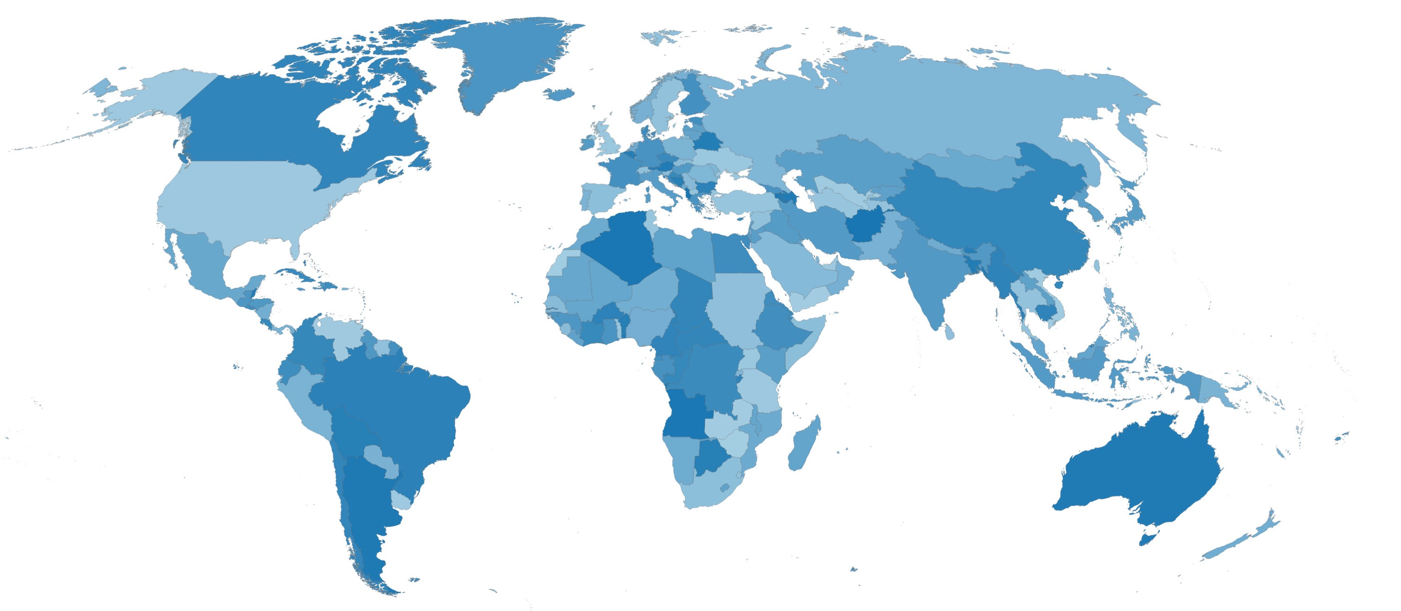
GLOBAL EARTHQUAKE HAZARD AND RISK MODEL
Snapshot of the Global Earthquake Risk Model layers

Slide 12
GEM IMPACT
^{From Knowledge to Application}

Slide 13
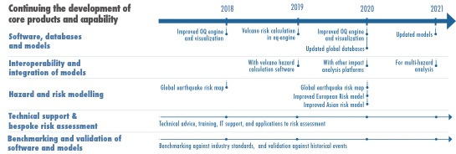
FUTURE WORK
Programs
Planned Activities & Schedule of Deliverables

Slide 14
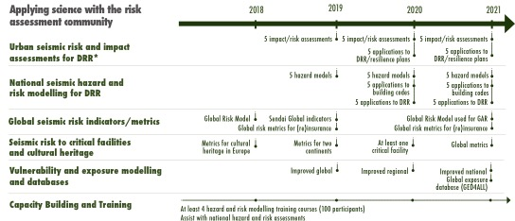
FUTURE WORK
Programs
Planned Activities & Schedule of Deliverables

Slide 15
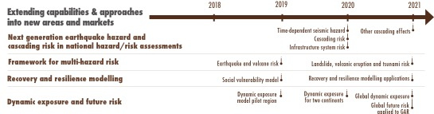
FUTURE WORK
Programs
Planned Activities & Schedule of Deliverables

Slide 16
HOW TO JOIN
Sponsor Types and Contributions

Slide 17
HOW TO JOIN
Contribution Levels based on GERD

