Slide 1
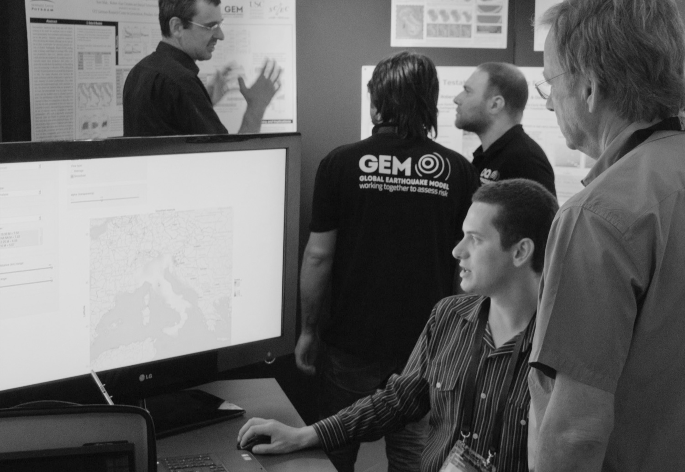
GEM Partnership Workshop
29 November 2017
Pavia, Italy

Slide 2



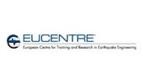



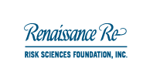






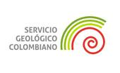






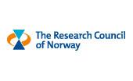
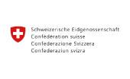
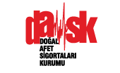


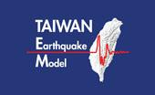












Private Participants
Australia
Canada
Chile
Colombia
Germany
Italy
Japan
Nepal
Public Participants
New Zealand
Norway
Switzerland
Taiwan
Turkey
United Kingdom
USA
Venezuela
Project Partners
Associates

Slide 3
Scientific Framework
unique approach
cohesive pathway
actionable solutions

Slide 4

PROJECTS
TRAINING
DATABASES
MODELS
SOFTWARE
What We Have Achieved
Develop range of open data and transparent tools.
Collaborate with scientists, government officials, engineers and disaster management practitioners
Empower stakeholders around the world.

Slide 5
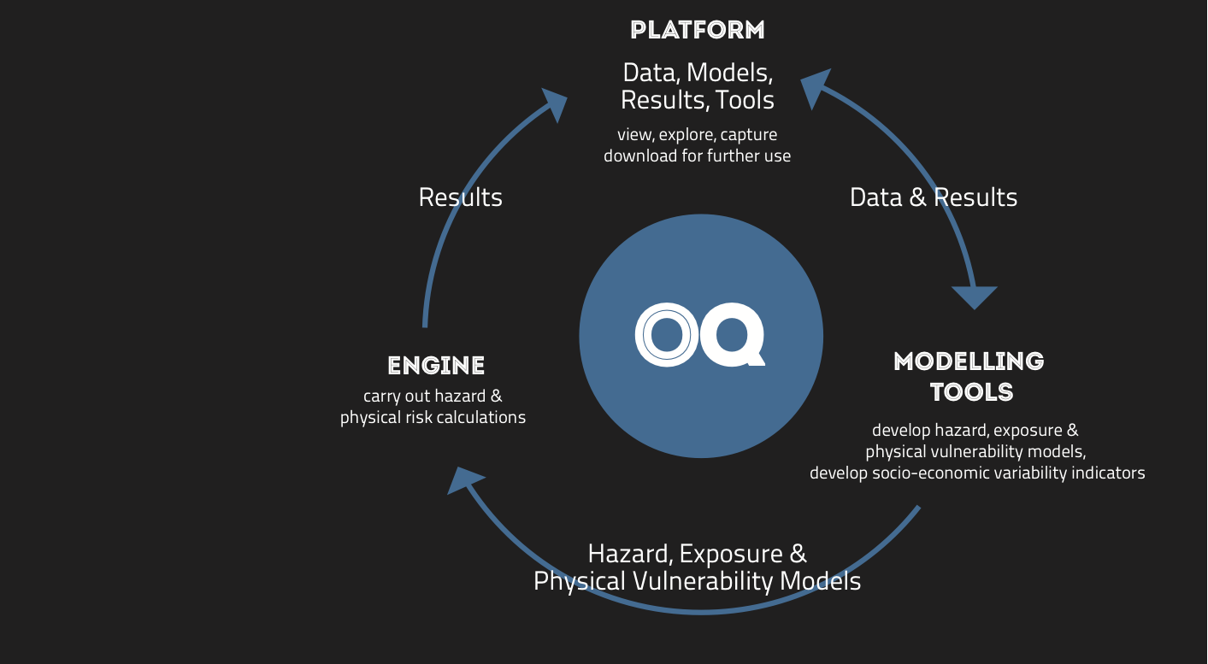

Slide 6
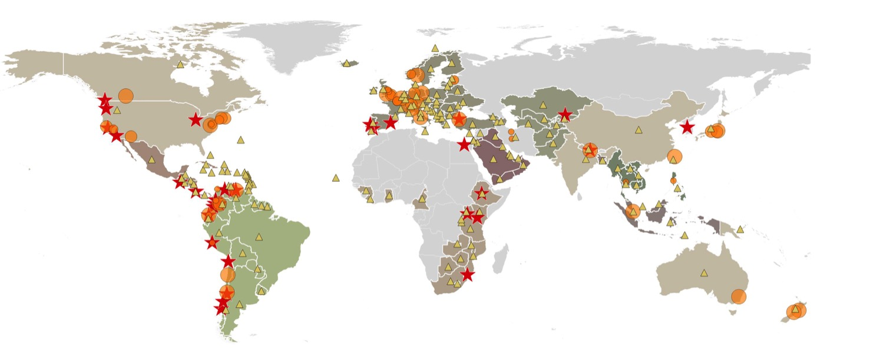
Public & private institutions, associate partners and collaborators
Countries
Workshop/Training sites
Regional and national project sites (colored shapes)
global
regional
national
local
Where We Work
GEM implements regional, national and local hazard, risk and social vulnerability assessment projects in the Americas, Europe, Middle East, Africa and Asia-Pacific, sharing knowledge, data and best practices to build capacity and bring together international and local experts.

Slide 7
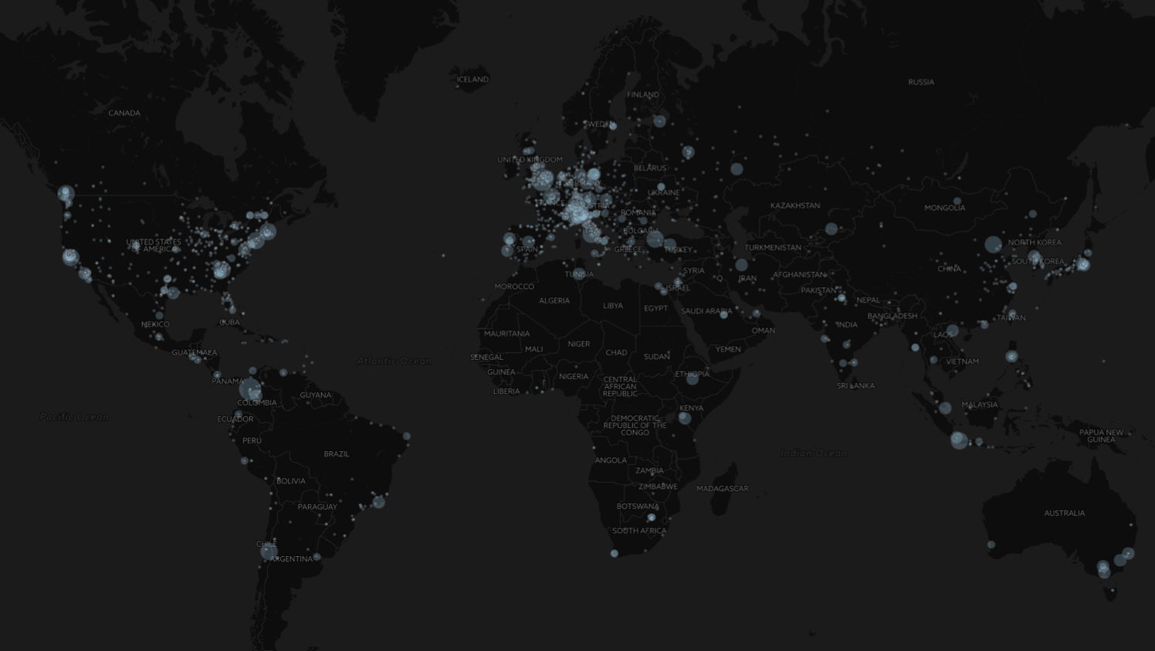
The OpenQuake Platform Users
accessed 2 600+ times from more than 200 countries since 2015

Slide 8
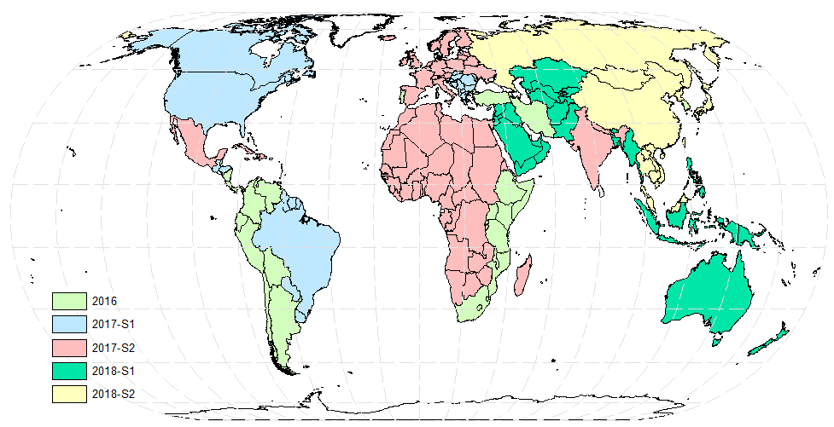
Global Risk Modelling
average annual losses, aggregated loss exceedance curves and probable maximum losses.

Slide 9
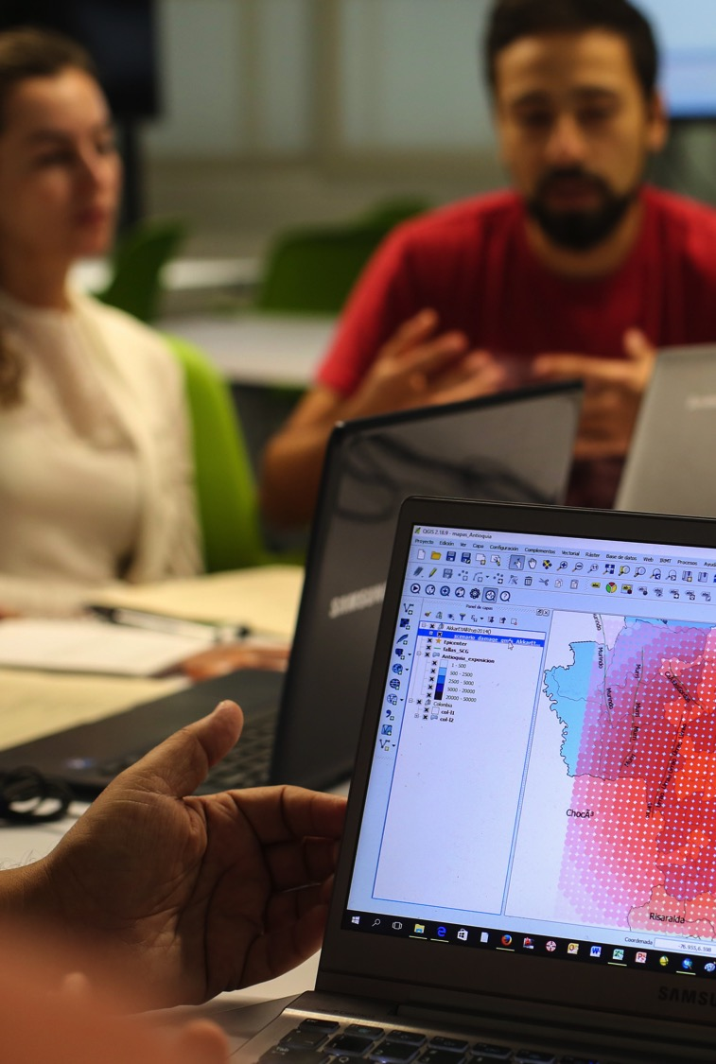
Future Program
Core Products & Services Development
Key activities
Ongoing support to our users
      Maintenance of software, databases and models
      Interoperability and integration
      Developing, improving hazard and risk models
      Technical support
      Bespoke risk assessment
      Benchmarking of software and models
Continued development of core products and capability

Slide 10
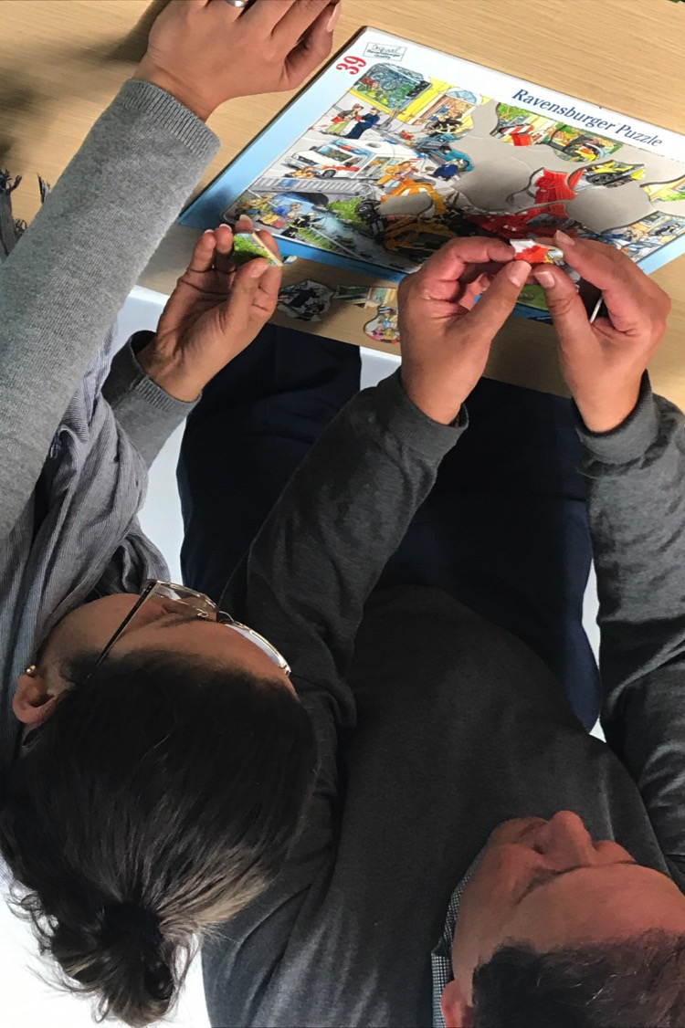
Future Program
Applying Science
Key activities
Using OQ tools and information for Risk Assessment
      Urban risk assessment and disaster risk reduction
      Probabilistic hazard modeling for building codes
      Sendai Framework Risk Indicators and Monitoring
      Risk to Critical facilities and Cultural Heritage
      Capacity building and teaching
Applying science in collaboration with the community; Shared ownership; Global disaster risk reduction (DRR)

Slide 11
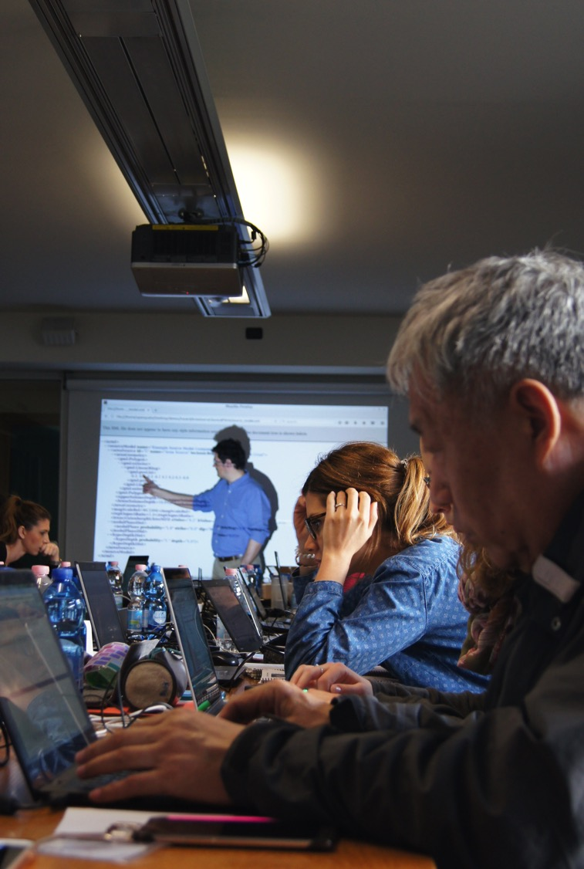
Future Program
Advancing Science
Key activities
  Research and technical development to expand our solution space
      Next generation earthquake hazard and cascading risk
      Multi-hazard risk assessment
      Recovery and resilience modeling
      Dynamic Exposure and Future Risk
Extending capabilities, approaches into new areas/markets

