Slide 1
Willis Research Network

Slide 2
THE WILLIS RESEARCH NETWORK
A transmission mechanism for delivering research impact into the global re/insurance industry
Identifies and makes commercial use of science that will change the way our business works
An award winning collaboration between public science and the finance academia sector with over 50 institutions, universities and firms
Uniquely positioned to use global and local resources for focused research of key issues
Members that span a full spectrum of risks of interest to our clients and the industry's evolving regulatory landscape
Notes:
An award winning collaboration between public science and the finance academia sector with over 50 institutions, universities and firms, strengthening the link between industry and academia

Slide 3
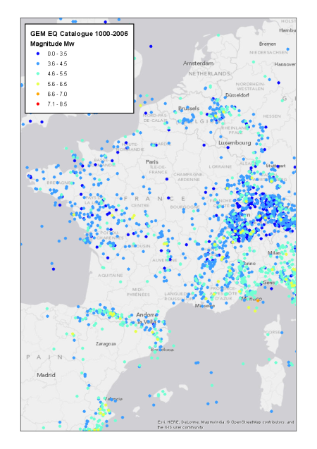
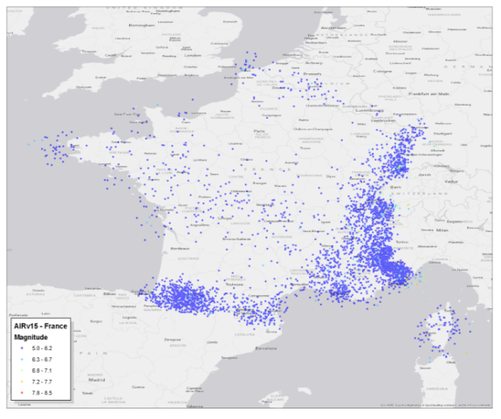
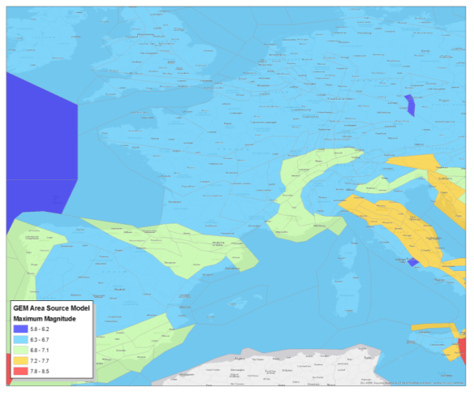
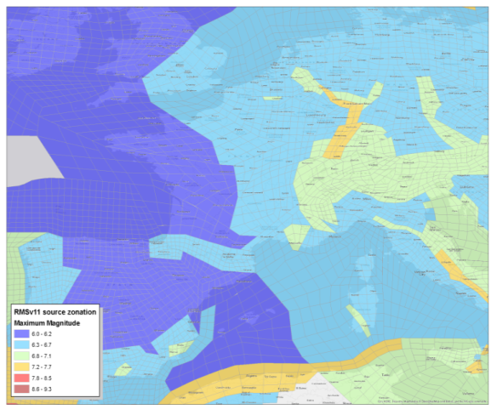
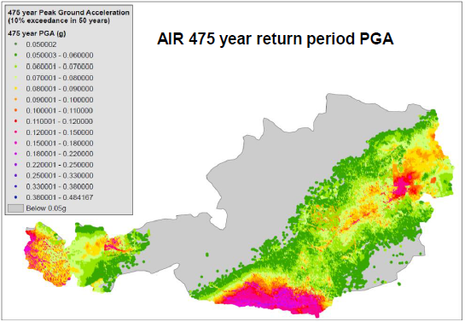
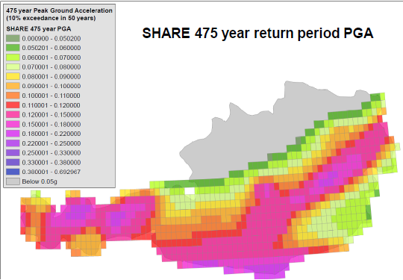
HISTORICAL EVENT SET AND SEISMIC HAZARD MAP
Model 1
Model 2
Model 1 hazard map

Slide 4
First step in developing own view of risk
REALISTIC DISASTER SCENARIOS
Why develop a custom-made RDS?
Alternative view of EQ risk when compared to probabilistic model outputs
Increase certainty of PML estimate bespoke to the selected portfolio
Examine impact of low-frequency, high severity, events that might not be modelled by available cat models
What data do we use to build an Earthquake RDS?
e.g. Global Earthquake Model (GEM), among other sources
1) RDS footprints: Determine EQ scenarios based on exposure and seismicity
3) Loss Severity & Frequency: Derive damage ratios at different locations
5) RDS loss estimates: Identify improvements and their potential impact
2) RDS loss propensity: Use GEM to generate EQ shaking footprints
4) Apply the footprints and damage ratios to the selected exposure

Slide 5
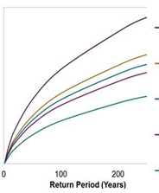
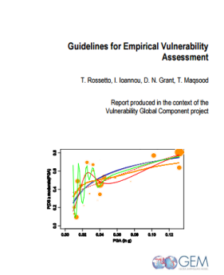
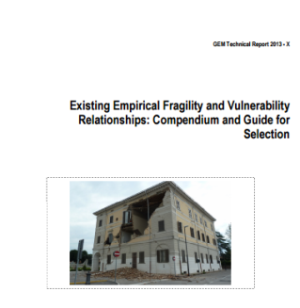
BESPOKE EQ PROBABILISTIC MODEL
Hazard
Vulnerability
Calibration
Use of state-of-the-art research
Overcome key shortcomings of existing models, if available
Obtain a more accurate view of risk
Develop vulnerability curves appropriate for the specific insured building stock
Utilise guidelines by GEM on the selection of appropriate curves for risk modelling
Bespoke model calibration using appropriate data
Example: Calibrate EP curves to market and appropriate losses

Slide 6
IDEAS FOR THE FUTURE
Vulnerability development
Empirical assessment with damage data from recent events
Focus on loss along with damage data
Soil modelling
Soil property, e.g. Vs30, maps at global level
Liquefaction susceptibility maps
Exposure modelling at global scale

