Slide 1
IF and GEM
29 November 2017
Prepared by Goran Trendafiloski, Jan Vodicka and Adam Podlaha of Impact Forecasting

Slide 2
Agenda
Section 1 Impact Forecasting Introduction
Section 2 Impact Forecasting and Global Earthquake Model
Section 3 Discussion

Slide 3

Section 1: Impact Forecasting Introduction

Slide 4
About Impact Forecasting
Cat model platform
ELEMENTS
Cat Model Developers
90 team members in 5 time zones
Committed to Oasis
Part of Aon Benfield
Natural and man-made hazards
Catastrophe model development team
Independent, transparent, open, modular and bespoke models
Natural (flood, earthquake, wind) and man-made perils
Filling the gaps and main perils
Products licensed to over 60 insurers, reinsurers, model developers and consultants

Slide 5
Impact Forecasting offers
Probabilistic and scenario models
Custom model development
Hazard and Risk data for primary underwriting
ELEMENTS as a loss calculation platform
Catastrophe events reporting
Notes:
What are we about? About these 5 main things:
We licence our models
How we create models? We either build market models or we create client specific models
What is the biggest obstacle for a new model developer to sell the model – the workflow and that’s why ELE is used to deploy third party models
In some countries the rate should correspond with the exposure, for that cat models can be used to help set up the rates
Finally many of your are receiving our cat alerts and reports like Nepal about the events but also about the possible lossses

Slide 6
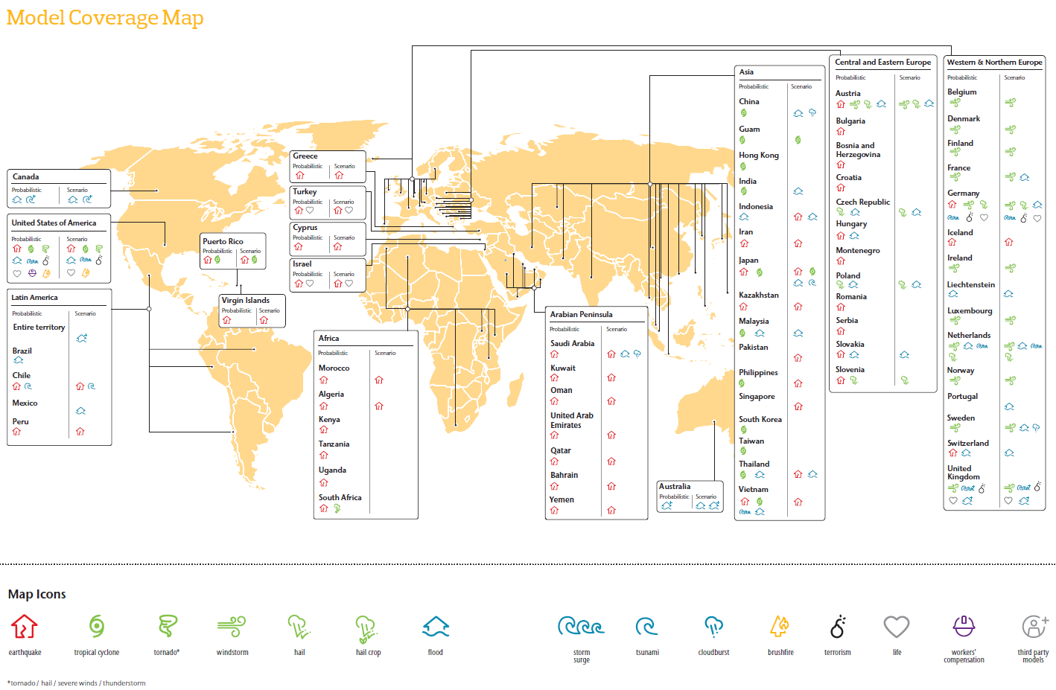

Slide 7
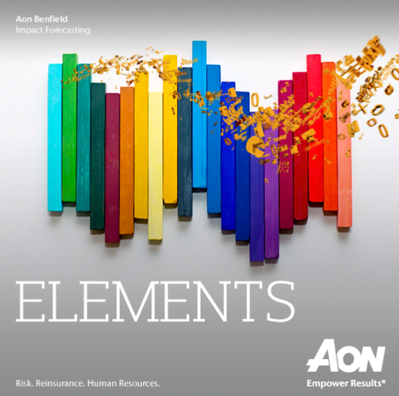
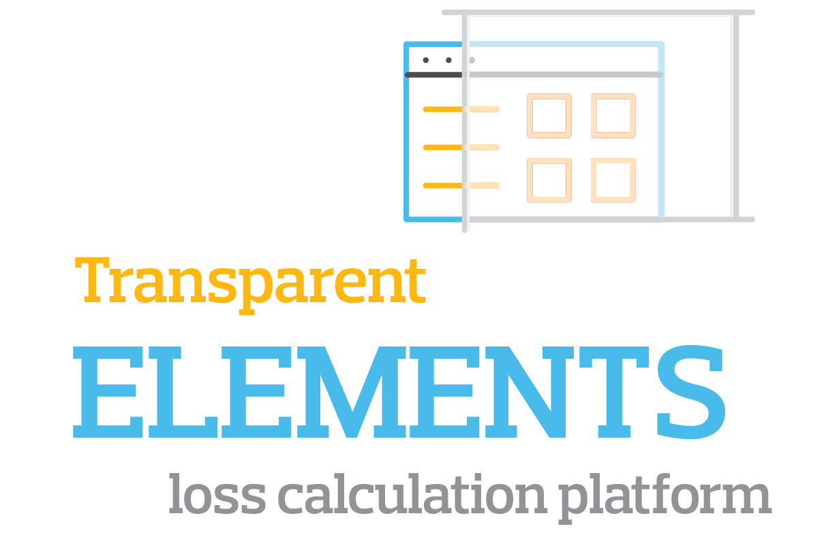


ELEMENTS
Notes:
ELEMENTS is our loss calculation platform, it:
Supports our models
It supports 3rd party models
Its available as a local or cloud install
As already noted it is very transparent, with the installation you get access and tools to all the hazard event set and other layers and to the damage functions

Slide 8
Three pillars of Impact Forecasting
1. High Quality Models
2. Understandable
3. Accessible
Notes:
And now when you know a bit how can you access our cat modelling toolkit I would like to wish you to enjoy exploring it further with us

Slide 9
Section 2: Impact Forecasting and Global Earthquake Model
Current collaboration
IF EQ model technical overview
IF and GEM potential collaboration

Slide 10
Potential types of IF and GEM collaborations
Use of GEM data to build IF models
GEM models in ELEMENTS
Real-time loss assessment
IF – GEM models
Part of Aon Benfield Research
Notes:
What are we about? About these 5 main things:
We licence our models
How we create models? We either build market models or we create client specific models
What is the biggest obstacle for a new model developer to sell the model – the workflow and that’s why ELE is used to deploy third party models
In some countries the rate should correspond with the exposure, for that cat models can be used to help set up the rates
Finally many of your are receiving our cat alerts and reports like Nepal about the events but also about the possible lossses

Slide 11
Current collaboration: IF Iran Earthquake model
Use of GEM data to build IF models
IF Iran EQ model built using GEM data (model components)
Hazard component (stochastic event set and hazard footprints) incorporated in IF model
Damage curves used to benchmark IF damage curves
GEM economic exposure database used to calibrate the model
Notes:
What are we about? About these 5 main things:
We licence our models
How we create models? We either build market models or we create client specific models
What is the biggest obstacle for a new model developer to sell the model – the workflow and that’s why ELE is used to deploy third party models
In some countries the rate should correspond with the exposure, for that cat models can be used to help set up the rates
Finally many of your are receiving our cat alerts and reports like Nepal about the events but also about the possible lossses

Slide 12
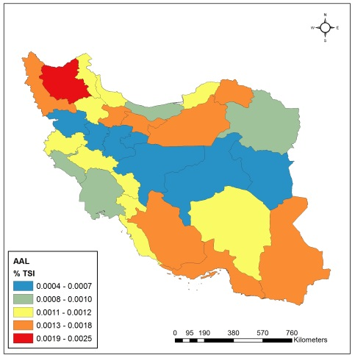
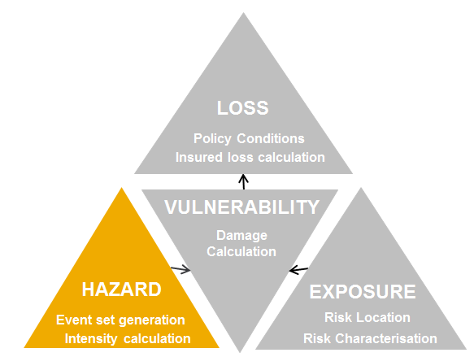
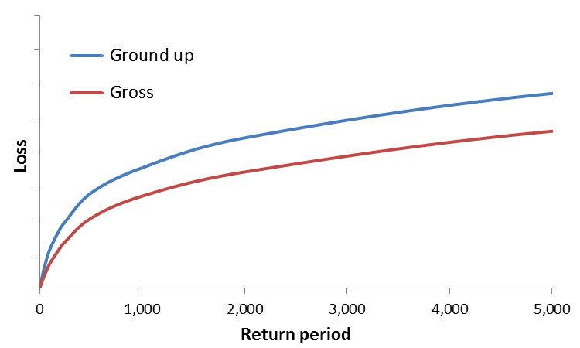
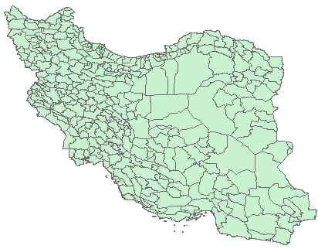
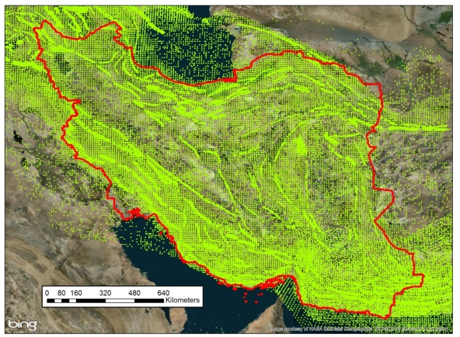
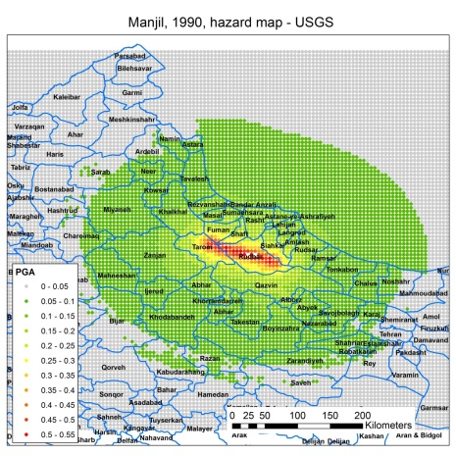
Anatomy of earthquake catastrophe models
AAL map
EP loss curve
Damage curve and COL
Sample geocoding precision
Stochastic event set
Hazard footprint

Slide 13
Collaboration with GEM is beneficial for the market
…because it provides new / alternative view of risk to the market to the technical and the less technical insurers and reinsurers
… from our point of view:
GEM provides:
  State of the art science (=model components)
  Access to local country specific research sources and data
  Software to deliver its data
  Credibility based on GEM name
IF provides:
  Review of model components and its own model components
  Model “completion”: developing a commercial market model in ELEMENTS or Oasis
  ELEMENTS is a robust loss calculation platform with insurance conditions
  Exposure of the model at the market
  Distribution, maintenance, training for model users

Slide 14
Section 3: Discussion

Slide 15
Impact Forecasting Contacts
Adam Podlaha
Impact Forecasting London
adam.podlaha@aonbenfield.com
Goran Trendafiloski
Impact Forecasting London
goran.trendafiloski@aonbenfield.com
Jan Vodicka
Impact Forecasting Prague
jan.vodicka@aonbenfield.com

Slide 16
Disclaimer
Legal Disclaimer
© Aon UK Limited trading as Aon Benfield (for itself and on behalf of each subsidiary company of Aon Plc) (“Aon Benfield”) reserves all rights to the content of this report or document (“Report”). This Report is for distribution to Aon Benfield and the organisation to which it was originally delivered by Aon Benfield only (the “Recipient”). Copies may be made by that organisation for its own internal purposes but this Report may not be distributed in whole or in part to any third party without both (i) the prior written consent of Aon Benfield and (ii) the third party having first signed a “recipient of report” letter in a form acceptable to Aon Benfield. This Report is provided as a courtesy to the recipient and for general information and marketing purposes only. The Report should not be construed as giving opinions, assessment of risks or advice of any kind (including but not limited to actuarial, re/insurance, tax, regulatory or legal advice). The content of this Report is made available without warranty of any kind and without any other assurance whatsoever as to its completeness or accuracy.
Aon Benfield does not accept any liability to any Recipient or third party as a result of any reliance placed by such party on this Report. Any decision to rely on the contents of this Report is entirely the responsibility of the Recipient. The Recipient acknowledges that this Report does not replace the need for the Recipient to undertake its own assessment or seek independent and/or specialist risk assessment and/or other relevant advice.
The contents of this Report are based on publically available information and/or third party sources (the “Data”) in respect of which Aon Benfield has no control and such information has not been verified by Aon Benfield. This Data may have been subjected to mathematical and/or empirical analysis and modelling in producing the Report. The Recipient acknowledges that any form of mathematical and/or empirical analysis and modelling (including that used in the preparation of this Report) may produce results which differ from actual events or losses.
Limitations of Catastrophe Models
This report includes information that is output from catastrophe models of Impact Forecasting, LLC (IF). The information from the models is provided by Aon Benfield Services, Inc. (Aon Benfield) under the terms of its license agreements with IF. The results in this report from IF are the products of the exposures modelled, the financial assumptions made concerning deductibles and limits, and the risk models that project the pounds of damage that may be caused by defined catastrophe perils. Aon Benfield recommends that the results from these models in this report not be relied upon in isolation when making decisions that may affect the underwriting appetite, rate adequacy or solvency of the company. The IF models are based on scientific data, mathematical and empirical models, and the experience of engineering, geological and meteorological experts. Calibration of the models using actual loss experience is based on very sparse data, and material inaccuracies in these models are possible. The loss probabilities generated by the models are not predictive of future hurricanes, other windstorms, or earthquakes or other natural catastrophes, but provide estimates of the magnitude of losses that may occur in the event of such natural catastrophes. Aon Benfield makes no warranty about the accuracy of the IF models and has made no attempt to independently verify them. Aon Benfield will not be liable for any special, indirect or consequential damages, including, without limitation, losses or damages arising from or related to any use of or decisions based upon data developed using the models of IF.
Additional Limitations of Impact Forecasting, LLC
The results listed in this report are based on engineering / scientific analysis and data, information provided by the client, and mathematical and empirical models. The accuracy of the results depends on the uncertainty associated with each of these areas. In particular, as with any model, actual losses may differ from the results of simulations. It is only possible to provide plausible results based on complete and accurate information provided by the client and other reputable data sources. Furthermore, this information may only be used for the business application specified by Impact Forecasting, LLC and for no other purpose. It may not be used to support development of or calibration of a product or service offering that competes with Impact Forecasting, LLC. The information in this report may not be used as a part of or as a source for any insurance rate filing documentation.
THIS INFORMATION IS PROVIDED “AS IS” AND IMPACT FORECASTING, LLC HAS NOT MADE AND DOES NOT MAKE ANY WARRANTY OF ANY KIND WHATSOEVER, EXPRESS OR IMPLIED, WITH RESPECT TO THIS REPORT; AND ALL WARRANTIES INCLUDING WARRANTIES OF MERCHANTABILITY AND FITNESS FOR A PARTICULAR PURPOSE ARE HEREBY DISCLAIMED BY IMPACT FORECASTING, LLC. IMPACT FORECASTING, LLC WILL NOT BE LIABLE TO ANYONE WITH RESPECT TO ANY DAMAGES, LOSS OR CLAIM WHATSOEVER, NO MATTER HOW OCCASIONED, IN CONNECTION WITH THE PREPARATION OR USE OF THIS REPORT.

