Slide 1
GEM Partnership Workshop
Pavia, November 29, 2017
Claudio Böttcher
Group Head of Property & Business Interruption
Group Underwriting

Slide 2
Zurich Rationale for becoming a GEM founding sponsor (2008)
Increase individual awareness of the risk, especially in emerging markets
Support the science without interference from us
Promote risk management, especially facilitated by increased awareness.
For some, this might mean buy some insurance
For others it would mean improve building codes, life line protection, metropolitan safety planning etc.
Additional points:
Corporate Responsibility
Zurich Commitment (Communities)
Thought Leadership
Sustainable Societies

Slide 3
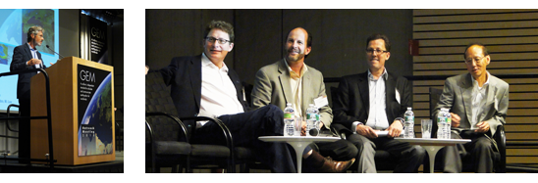
Zurich Perception in GEM GEM outreach Meeting 2010 Washington

Slide 4
Current collaboration
Diana Contreras (GEM) and Michael Szoenyi (Zurich) are exchanging and leveraging
GEM’s Resilience Performance Scorecard (RPS) methodology and Zurich’s Flood Resilience Program methodology (5C-4R framework)
This consists of 5 capitals (human, social, physical, natural and financial) as well as 4 properties of a resilient system (robustness, redundancy, resourcefulness and rapidity).
It is then translated into a risk grading scale with A being best practice and D significantly below good standard.
We believe that there are opportunities for both GEM and Zurich to further leverage knowledge and expertise in the resilience area.

Slide 5
Potential future collaboration
Meeting held in Zurich on November 8, 2017
for GEM: John Schneider and Anselm Smolka
for Zurich’s Global Cat Management: Iwan Stalder, Mathias Graf, Roland Schoebi ,
for Zurich’s Group Underwriting Claudio Böttcher.
The potential agenda is currently being worked out (some of the ideas discussed included OASIS, validation of models, closing gaps around the globe, etc.)

