Slide 1
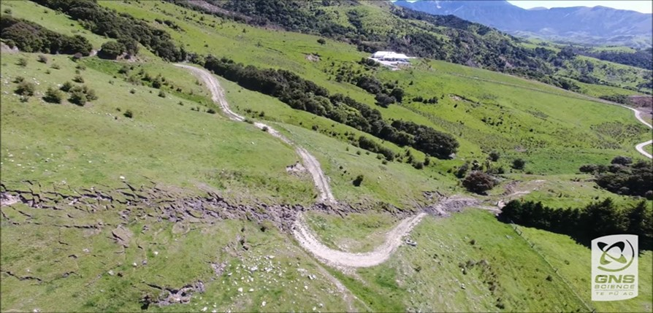
New Zealand participation in GEM 2006-2017
Kelvin Berryman,
Principal Scientist, GM Strategic Relationships
Natural Hazards Division

Slide 2
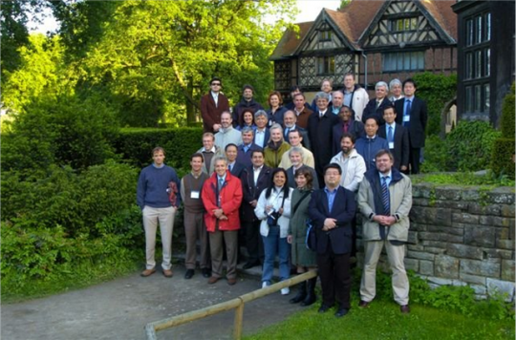
Potsdam 2006 – global science forum of OECD
Lindholm
Berryman
Zschau
Wiemer
Wald
Giardini

Slide 3
GEM key events
Potsdam Workshop (2006) recommendation was the creation of an international “Global Earthquake Risk Map” initiative.
In 2007 an international Steering Committee was set up to prepare detailed documents for establishing the Global Earthquake Model (GEM) as an international public/private project.
In February 2008, a third workshop was held in Paris with the objective of finalizing the GEM Business Plan.
On 14-16 June 2008, a strategic planning meeting was held in Zurich to present GEM to the global professional community.
In November 2008, EUCENTRE in Pavia, Italy, was selected by the interim Governing Board as the host institution for the GEM Secretariat.
On 9 March 2009, the GEM Foundation, a non-profit organisation, was incorporated and became a legal entity.

Slide 4
GEM key events
Potsdam Workshop (2006) recommendation was the creation of an international “Global Earthquake Risk Map” initiative.
In 2007 an international Steering Committee was set up to prepare detailed documents for establishing the Global Earthquake Model (GEM) as an international public/private project.
In February 2008, a third workshop was held in Paris with the objective of finalizing the GEM Business Plan.
On 14-16 June 2008, a strategic planning meeting was held in Zurich to present GEM to the global professional community.
In November 2008, EUCENTRE in Pavia, Italy, was selected by the interim Governing Board as the host institution for the GEM Secretariat.
On 9 March 2009, the GEM Foundation, a non-profit organisation, was incorporated and became a legal entity.
How to manage the risk appropriately?
Evidence-based decision support tools
Impact models and alternate recovery scenarios depending on mitigation
Balance treatment between accept, reduce, avoid, transfer

Slide 5
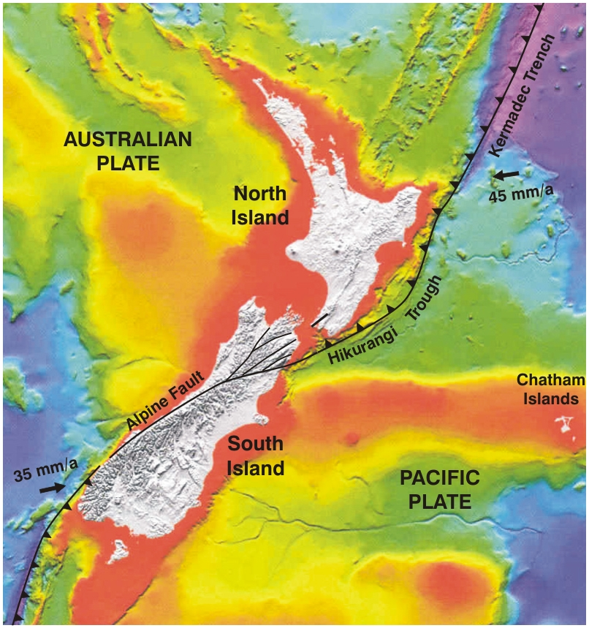
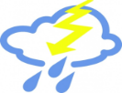
Where are we: the New Zealand situation
Almost the antipodes of Pavia – 35-47° south, 166-178° east
In the Roaring 40’s westerly wind belt – high winds and rainfall
Soft rocks & steep topography
On a plate boundary – earthquakes, volcanoes and tsunamis

Slide 6
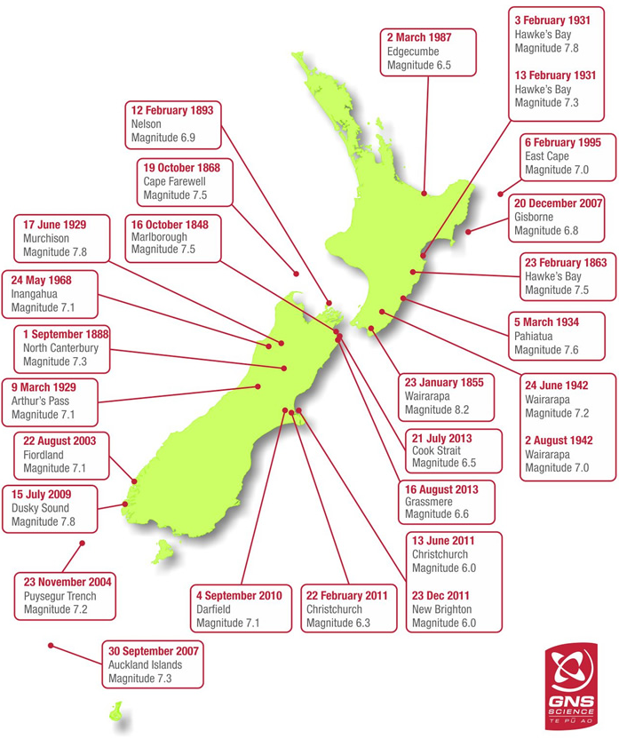
Recent New Zealand earthquake experience
2003-?
Since 2003 a cluster of M>7 events (4 times higher rate than average of ~200 yr record)
22 August 2003
Fiordland
Magnitude 7.1
23 November 2004
Puysegur Trench
Magnitude 7.1
30 Sept 2007
Auckland Islands
Magnitude 7.3
15 July 2009
Dusky Sound
Magnitude 7.8
4 September 2010
Darfield
Magnitude 7.1
2 September 2016
East Cape
Magnitude 7.1
14 November 2016
Kaikoura
Magnitude 7.8

Slide 7
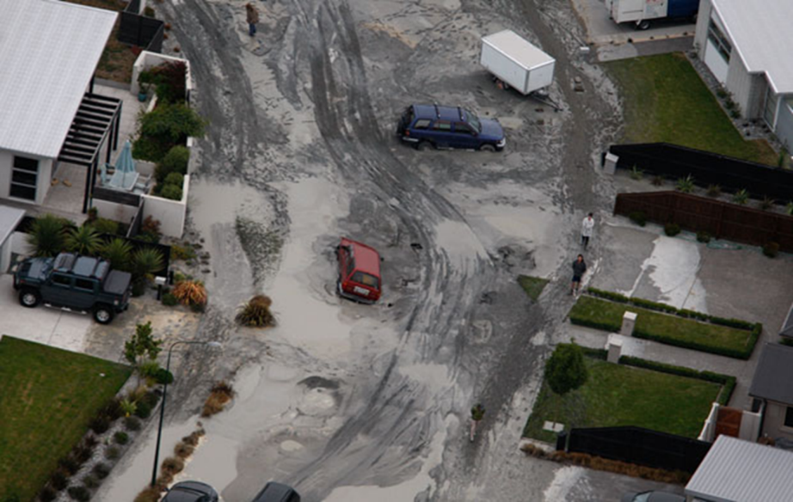
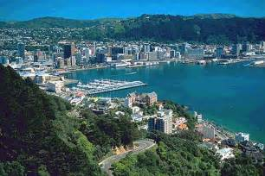
Current earthquake interests for New Zealand
Secondary Perils
- Liquefaction responsible for up to 50% losses in Canterbury earthquake sequence – where else?
Co-seismic landslides - the large secondary peril for
Wellington?
Local source tsunami generated by plate
boundary earthquakes are a major source of expected loss of life and damage

Slide 8
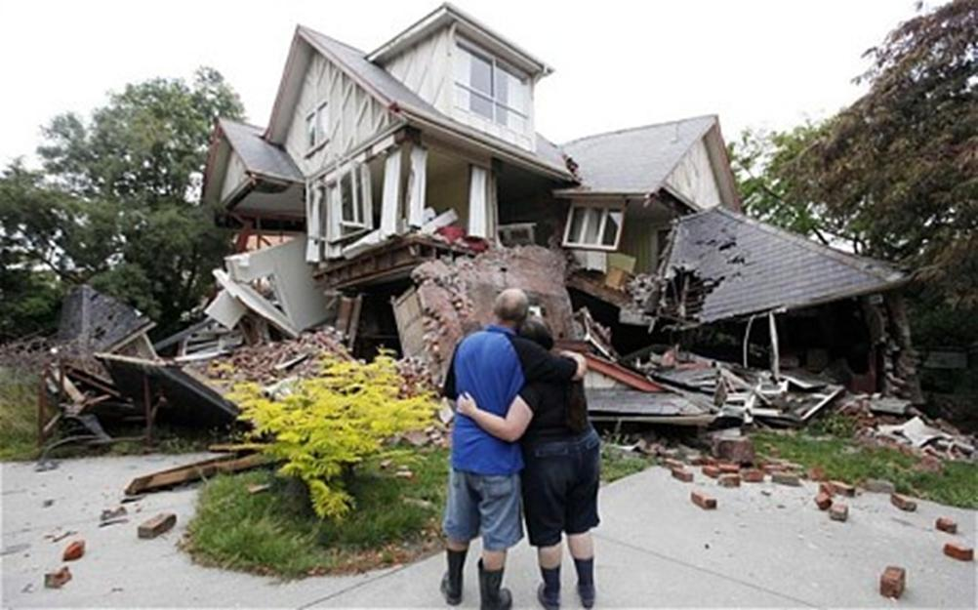
Current earthquake interests for New Zealand - continued
Modelling indirect social & economic impacts
Direct and insured losses are a good start (incl 2Y losses), but..
Indirect social and economic impacts likely to be larger
Modelling indirect losses critical for demonstrating cost-benefit of DRR investment
Improved local government asset management

Slide 9
Recent Earthquake – Kaikoura M7.8, 14 Nov 2016

Slide 10
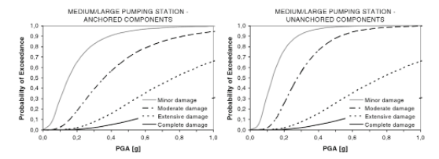
RISKSCAPE
Asset GIS Layer
Asset Attributes
Asset Fragility
Component
Functionality (T_{n})
Pump Station #215
Lon: 174.33 Lat: -41.5
Building: Reinforced brick masonry
Components Anchored: Yes
……..
Pump Station #455
Lon: 174.23 Lat: -41.9
Building: Reinforced brick masonry
Components Anchored: No
……..
Invest in Infrastructure upgrade
Intra-network
Dependency
Hazard Map (PGA)
T₀
T₀
T₊₇
T₊₇
T₊₃₀
Restoration & Interdependency
Model
T₊₃₀
Network Outage
Map (T_{n})
T₊₉₀
Assess social & economic impacts = MERIT
GNS Science tools

Slide 11
National Direction
Increase resilience of New Zealand to natural hazards
National CDEM Strategy Vision: “Resilient New Zealand – communities understanding and managing their hazards”
Building a culture of resilience
Improve understanding of risk to enable better risk-informed decision-making
Reduce existing risk and minimise creation of new risk
Strengthen resilience, both planned and adaptive
Sendai Framework
Paris Agreement
SDG’s

Slide 12
GEM – going forward
How has NZ used GEM products and expertise?
OpenQuake, discussion on risk, construction of asset databases and fragility functions, an open community of like-minded researchers and practitioners, enabled frequent engagement with reinsurers, reformatting fault data in GEM Faulted Earth framework
What research, products and services would be of greatest value to NZ in the future?
Seamless hazard and risk software, integration of social vulnerability in risk
What has GEM done well and what could GEM do better?
Addressed challenges of global standards, developed 21st century software, created global forum for discussion
What is the demand for GEM's hazard and risk products for emergency management applications?
Potentially (with some partner countries), needs to be arranged in advance

Slide 13
GEM – going forward (contd)
What are the key scientific questions that GEM should be addressing in the next implementation?
Hazard in fast developing economies of central America, SE Asia, China, south Asia, secondary perils of earthquake, indirect social and economic impacts, infrastructure vulnerability
What role should GEM play in supporting Sendai goals, such as in capacity building, modelling and risk monitoring?
Sendai (+ SDG’s + COP21) represent the major global environmental and natural hazards initiatives of our time; engagement in these global goals is relevant and strategic. What does this look like for GEM?
What opportunities for GEM to contribute to research and applications in resilience, multi-hazard risk, other?
The secondary perils of earthquake are a necessity, then collaboration with other global initiatives – flood, climate change, Natech, etc

Slide 14
Final Thoughts
New Zealand, supported by GNS Science, engages with GEM to access a global community of researchers, tools, and presents another engagement opportunity with insurers and reinsurers to further DRM and DRR in our national interest
GNS Science furthers its regional and global corporate responsibilities by joining forces with GEM as one mechanism for greater reach and impact
GNS Science remains committed to GEM as an avenue for uptake of our experience and expertise in earthquake research and disaster risk management that can be utilised regionally and globally

